Slide 1
Robustness of Bayesian Neural Networks to Gradient-Based Attacks NeurIPS 2020 #1
202111259 CSE 김수환

Slide 2

Contents
Abstract
Bayesian Neural Networks and Adversarial Attack
Adversarial robustness of Bayesian predictive distributions
Experiments
Conclusion

Slide 3
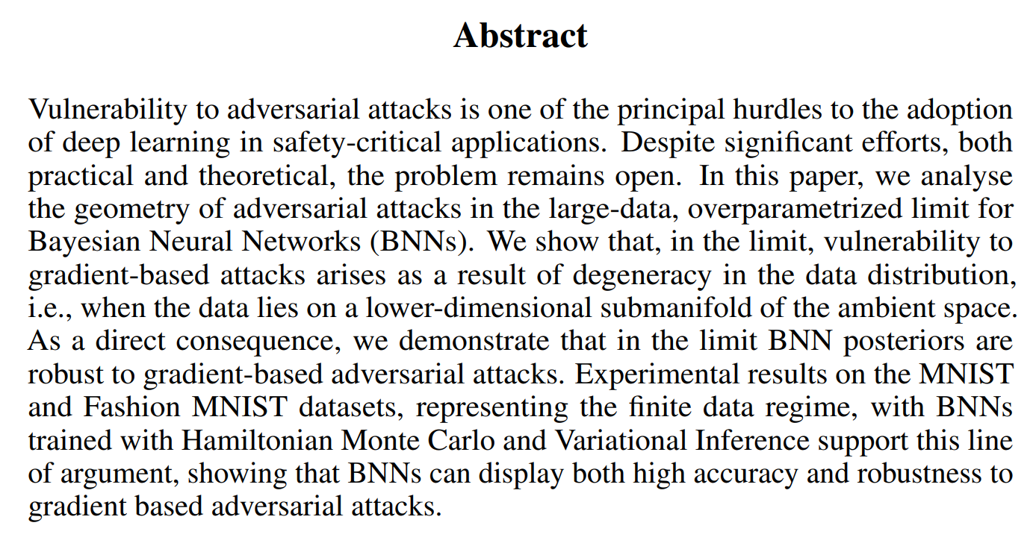





1. Abstract

Slide 4
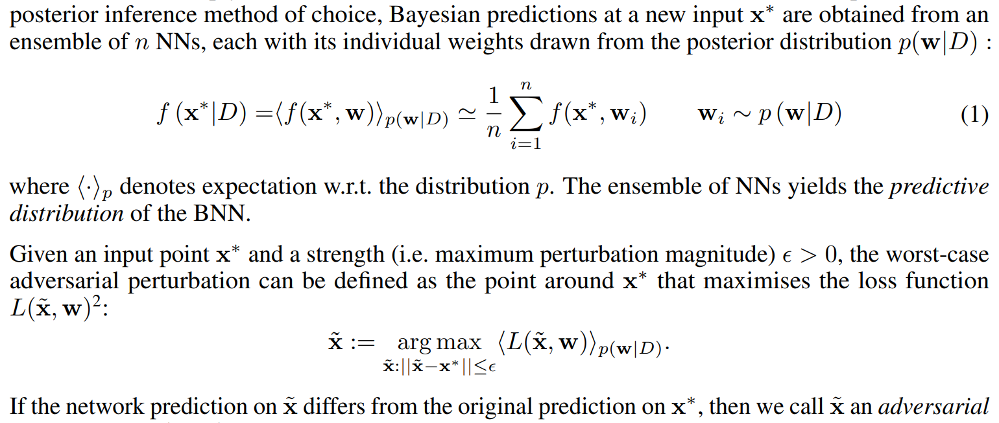
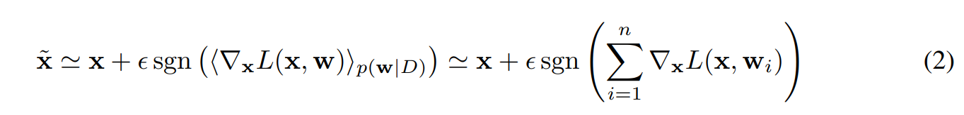


2. Bayesian Neural Networks and Adversarial Attack

Slide 5
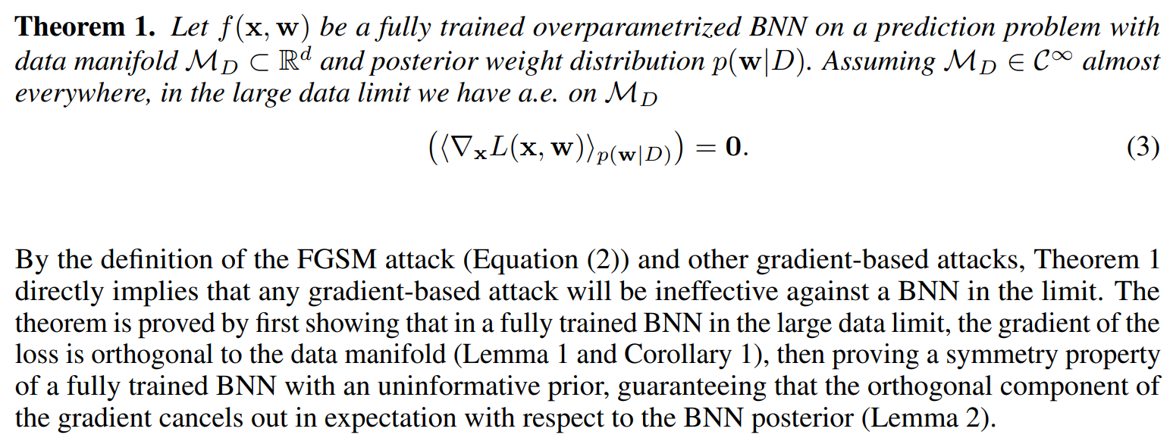

3. Adversarial robustness of Bayesian predictive distributions

Slide 6
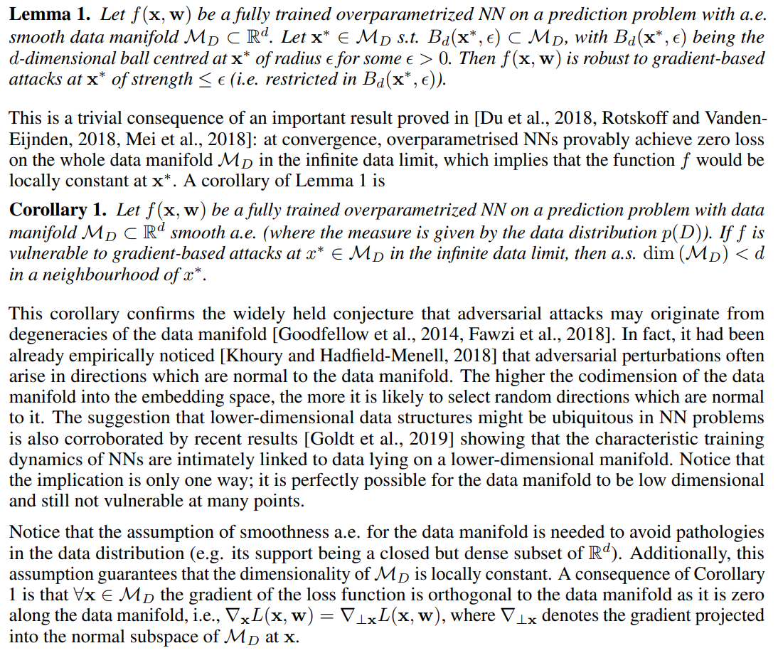
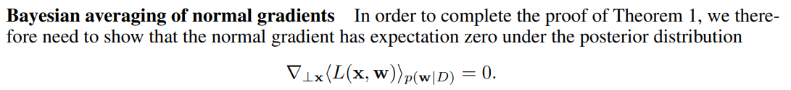



3. Adversarial robustness of Bayesian predictive distributions

Slide 7
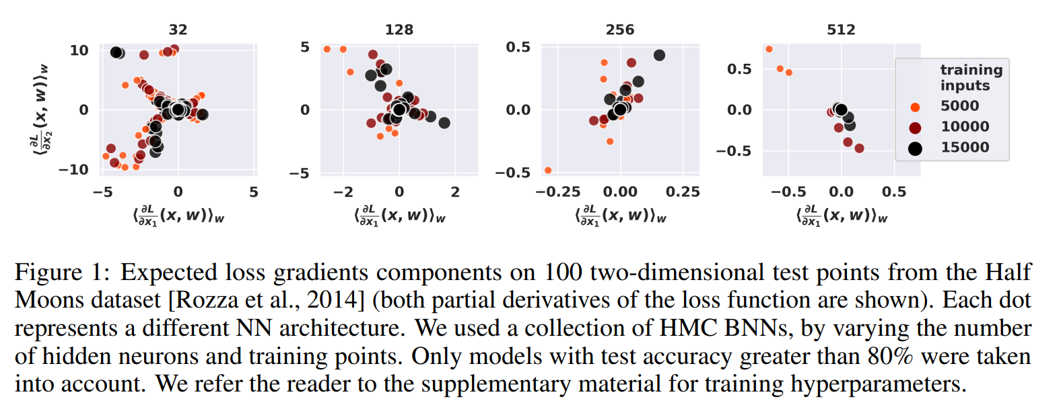
4. Experiments

Slide 8
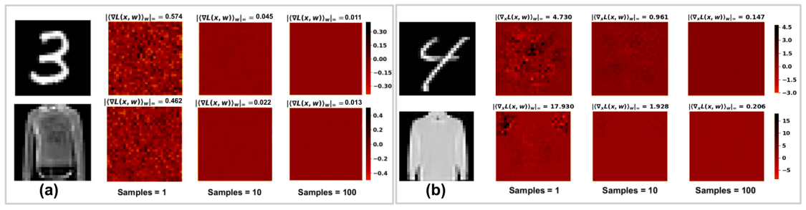
4. Experiments

Slide 9
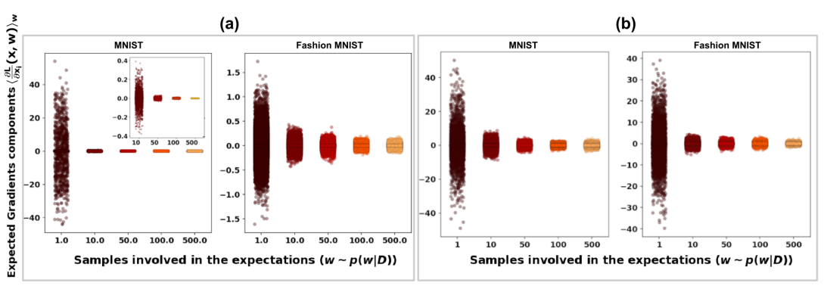
4. Experiments

Slide 10
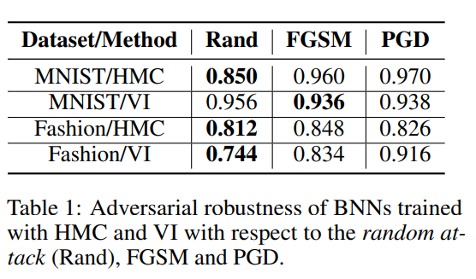
4. Experiments

Slide 11
5. Conclusion
- BNN은 NN의 ensemble로 볼 수 있고, MC로 추정 가능하다
- Adv perturbation은 다른 manifold로 projection 하며, manifold와 수직인 기울기를 사용한다.
- BNN의 manifold 수직 기울기의 expectation은 0이므로 robust하다.

